Slide 1
WP 3.3 A proposal for a transitions in geothermal RMS schemes
Results and Conclusions
Ferid Seyidov
19-th of March 2020

Slide 2
General Overview
Original Situation
Market Maturity and CRI Levels
Developed Risk Mitigation Scheme Structure
Financial Simulation and Results
Transition Criteria and Conditions

Slide 3
I. Original Situation

Slide 4
Risk Mitigation Schemes
Grants
Repayable grants
Convertible grants
Public insurance scheme
Public-Private Partnership
Private risk Insurance
Level of Risk
I
V
III
VI
IV
II
Market Maturity

Slide 5
Original Situation
Associated Conditions
Inappropriate support mechanism
Inefficient fund management
Ineffective risk mitigation
Low to no progress of the market
Generation of negative experience

Slide 6
II. Market Maturity and CRI Levels

Slide 7
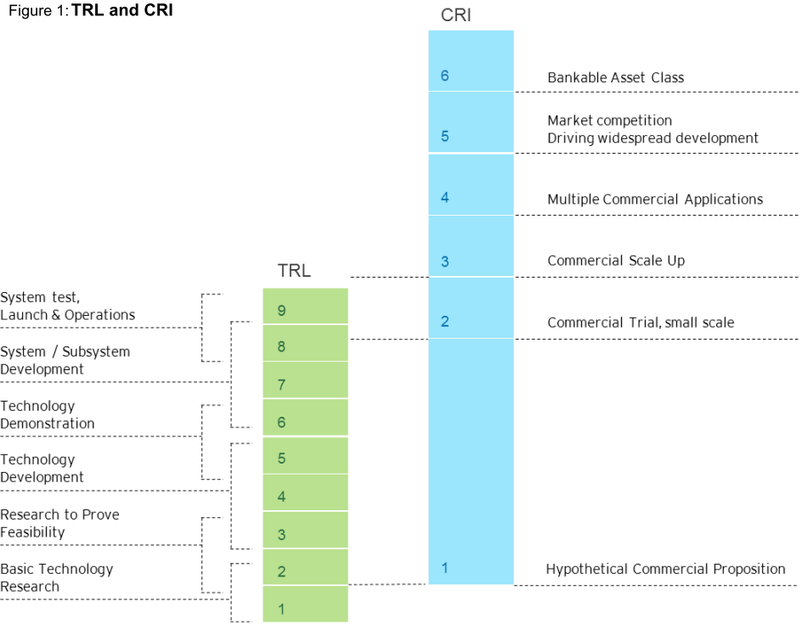
Source ARENA (2014); Correspondence of TRL and CRI

Slide 8
CRI Levels adaptation for Geothermal Market
Hypothetical commercial proposition – Presumption of the possibility to utilize Geothermal Energy in the region. Presumptions are made purely on theoretical data or with knowledge of regional geology. No test are preformed to support the claims.
Commercial Trial – Initiation of small scale pilot projects in order to test the theoretical presumption from level 1. Usually funded by governmental entities. Lead to development of commercial proposition based on the data from the trials.
Commercial Scale-up – The publicly available data and support programs (loans and grants) enable involvement of the private companies and stakeholders into the starting up geothermal market.
Multiple commercial applications – Presence of the geological and operational data proving technical performance and financial feasibility. Addressing regulatory challenges for smoothening and standardization of the licence acquisition processes. Despite rising interest from the private sector – public support is still needed.
Market competition driving widespread deployment & 6 Bankable grade asset class –
The regulatory environment became completely standardized. Presence of competitive product and service providing entities across all the segments of the market. The public support becomes no longer essential for maintaining the development of the market.

Slide 9
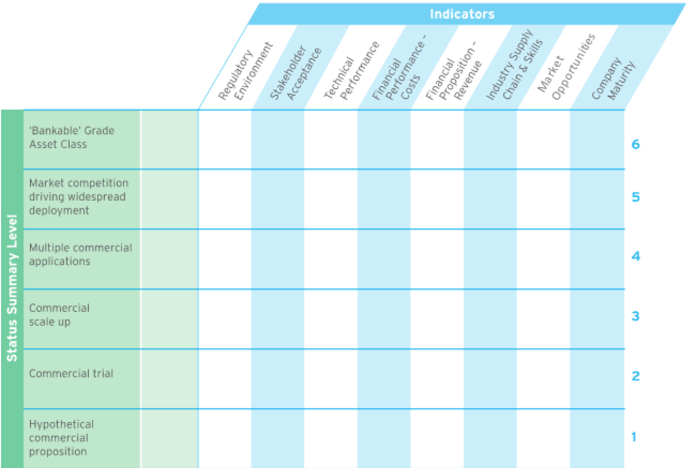
France Geothermal Market Evaluation
The evaluation of France is mainly based on market maturity in the region of Paris Basin.
As it could be seen in the chart, France has highly developed DH system, with CRI RMS value being equal to 4,8 could be deemed as reaching the full maturity of the geothermal market.
In contrast to that the CRI (RMS) value for CHP market has scored only 2,4, thereby indicating the vast difference present between these two systems.
District Heating
Power Generation

Slide 10
German Geothermal Market Evaluation
As it could be seen from the chart, the values for CHP and DH vary. Here DH has CRI (RMS) value of 3,3 and CHP 2,8. The highest divergence could be observed under Stakeholder Acceptance and the reason lies in direct benefit of DH plant, in contrast to CHP plants.
In addition, the negative experience with micro-seismic activity in immediate vicinity the CHP plant further deteriorates the readiness level of the community to accept this technology.
District Heating
Power Generation

Slide 11
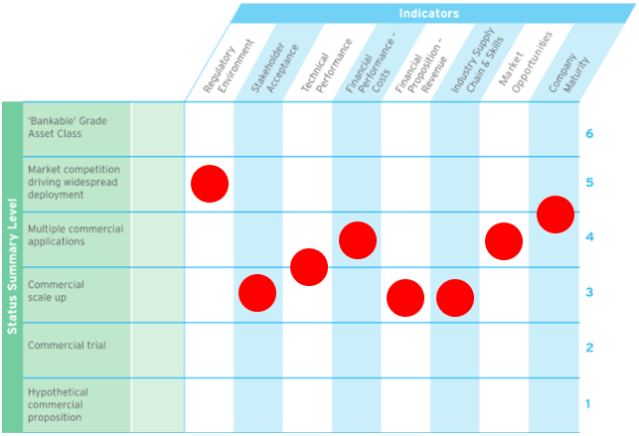
Turkish Geothermal Market Evaluation
Unlike the evaluations, received from Germany and France, in case of Turkey, due to the climate conditions and presence of medium to enthalpy high, the geothermal energy is primarily used for Power generation.
As one of the reliable sources of electricity, the government has promoted its utilization, thereby the CHP CRI evaluation are highest among all the partner countries. The CRI RMS value for Aegean Region is equal to 3,7.
District Heating
Power Generation

Slide 12
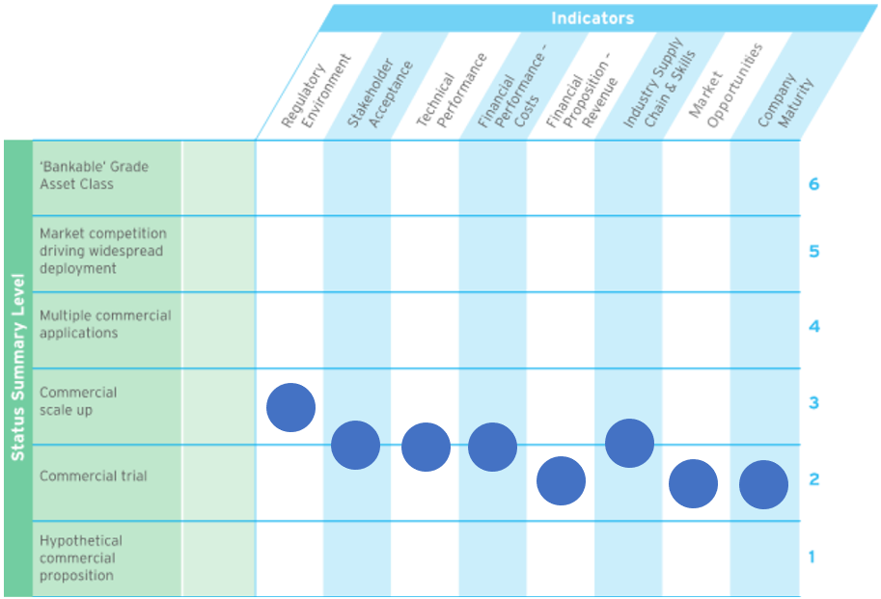
Polish Geothermal Market Evaluation
The situation in Poland is opposite to one in Turkey. Due having middle to low enthalpy reservoirs the primary geothermal application is district heating.
The evaluation has indicated still early stages of geothermal market development. The evaluated CRI (RMS) values is 2,4.
District Heating
Power Generation

Slide 13
Hungarian Geothermal Market Evaluation
The market conditions in Hungary could be described as uneven. The Regulatory Environment is quite high, however, other indicators are still at the early stages of the development.
The evaluated CRI (RMS) of District Heating Market value is 2,6 and the level of Power Generation is 2,0
District Heating
Power Generation

Slide 14
Greek Geothermal Market Evaluation
In case of Greece, it would again be a summary of the geothermal markets of three different regions: Aegean Volcanic Arc, Cyclades Region with shallow reservoirs and Deep Reservoirs.
As it could be seen from chart, the geothermal market in Greece is at the early stages of development. The CRI RMS of CHP market has the value of 1,9 and the one for DH is 2,3
District Heating
Power Generation

Slide 15
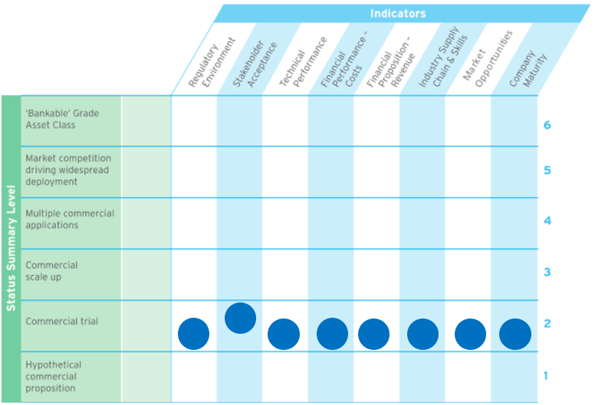
Swiss Geothermal Market Evaluation
Although the history of application of RMS in Switzerland could be deemed as relatively long, the evaluation of the market indicate that the Geothermal Market is still at the early stages of development.
Due to the low level of geological exploration of the subsurface area, the level of risk, even with the expense coverage of 60% through the support scheme, remain high. The overall evaluation of the CRI (RMS) has resulted with 2,3.
District Heating
Power Generation

Slide 16
III. Developed RMS Structure

Slide 17
Definition of the Risk Mitigation Schemes
Grants - The money is not expected to be paid back
Convertible Grants - The money can be repaid or returned in any other form
Repayable Grants – A loan, where the money will be repaid under certain conditions
Public Insurance - Insurance scheme that is sponsored by public, project must pay insurance premium
Private-Public Partnership - Scheme is sponsored by public-private partnership, project must pay support scheme fee.
Private Insurance -The insurance is covered completely by private entities, project must pay insurance premium

Slide 18
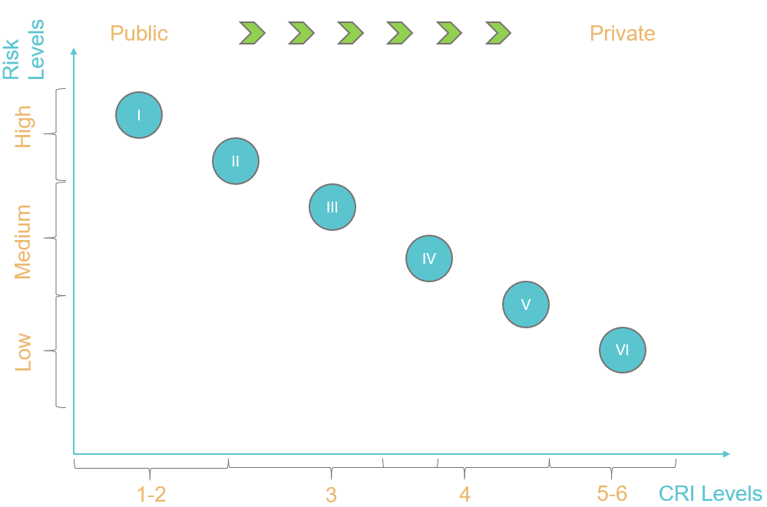
18
Risk Mitigation Schemes
Grants
Convertible grants
Repayable grants
Public insurance scheme
Public-Private Partnership
Private risk Insurance

Slide 19
Introduction of Market Maturity Levels
Associated Conditions
Proper Support of the Projects
Effective and efficient fund management
Stimulation of Market Growth
Gradual shift of the RMS Funding from public to private sectors

Slide 20
IV. Financial Simulation and Results

Slide 21
Simulation Information
Simulations are executed on “Renewalizer” financial simulation tool
The simulation will include 3 cases per RMS
  No Trouble Occurring
  Risk Occurrence without support of RMS
  Risk Occurrence with support of RMS
Note: Risk will be presented in the form of an overinvestment.
The Results will be presented in the forms of a Project NPV and IRR
In all simulated cases the project was successful.

Slide 22
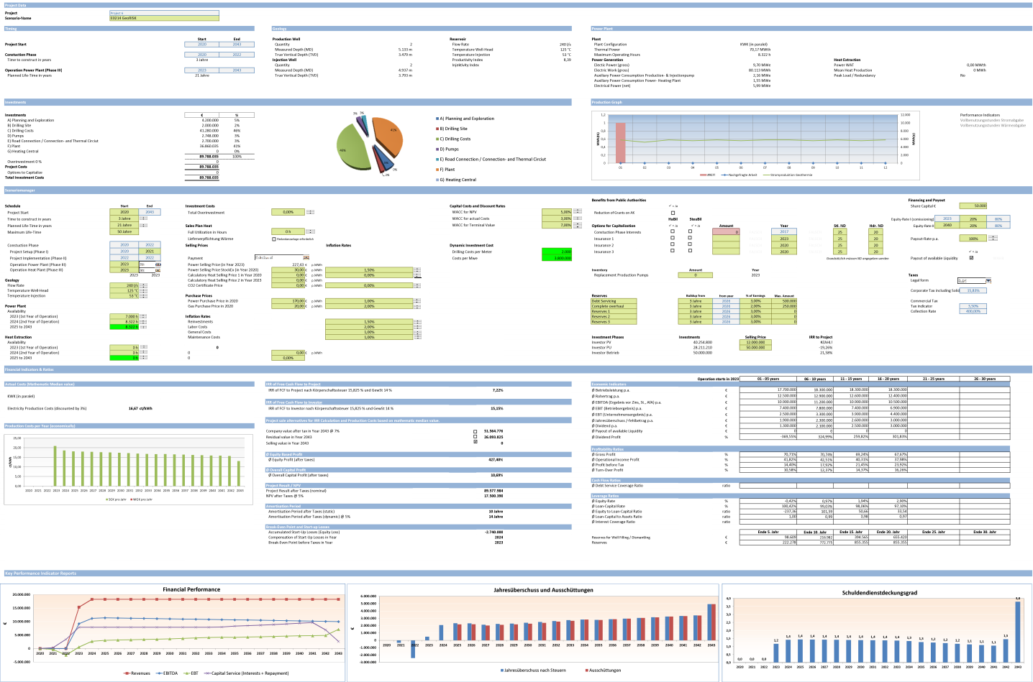

Slide 23
Background Assumptions
For simulations following assumptions were taken:
Feed-In Tariff fixed for all scenarios, only electricity, no heat sales
Investment constant for all scenarios
Project Lifetime 21 Years, no residual value after 21 years calculated
Interest rates; Equity 16%, Loan 4%
Presented outcome values will be after the taxation.

Slide 24
Project Data
Technical Data
Financial Data
True Vertical Depth 3.500 m
Flow Rate 240 l/s
Total Dissolved Solids 0,8 g/l
Temperature Well-Head 125 °C, Temperature Injection 53°C
Thermal Power 70,17 MWt
Electric Power (gross) 9,70 MWe
Pump pressure 60 bar
Availability 8.322h
CAPEX: 89,8 Mio. €
Total CAPEX Well 40 Mio.€ (Number of wells 4 (2+2))
OPEX: 1,5 Mio. €/a plus inflation
Inflation rate: 1-2%
Power Sales Price Electricity: 227,43 €/MWhe
Power Purchase Price Electricity: 170,00 €/MWhe

Slide 25
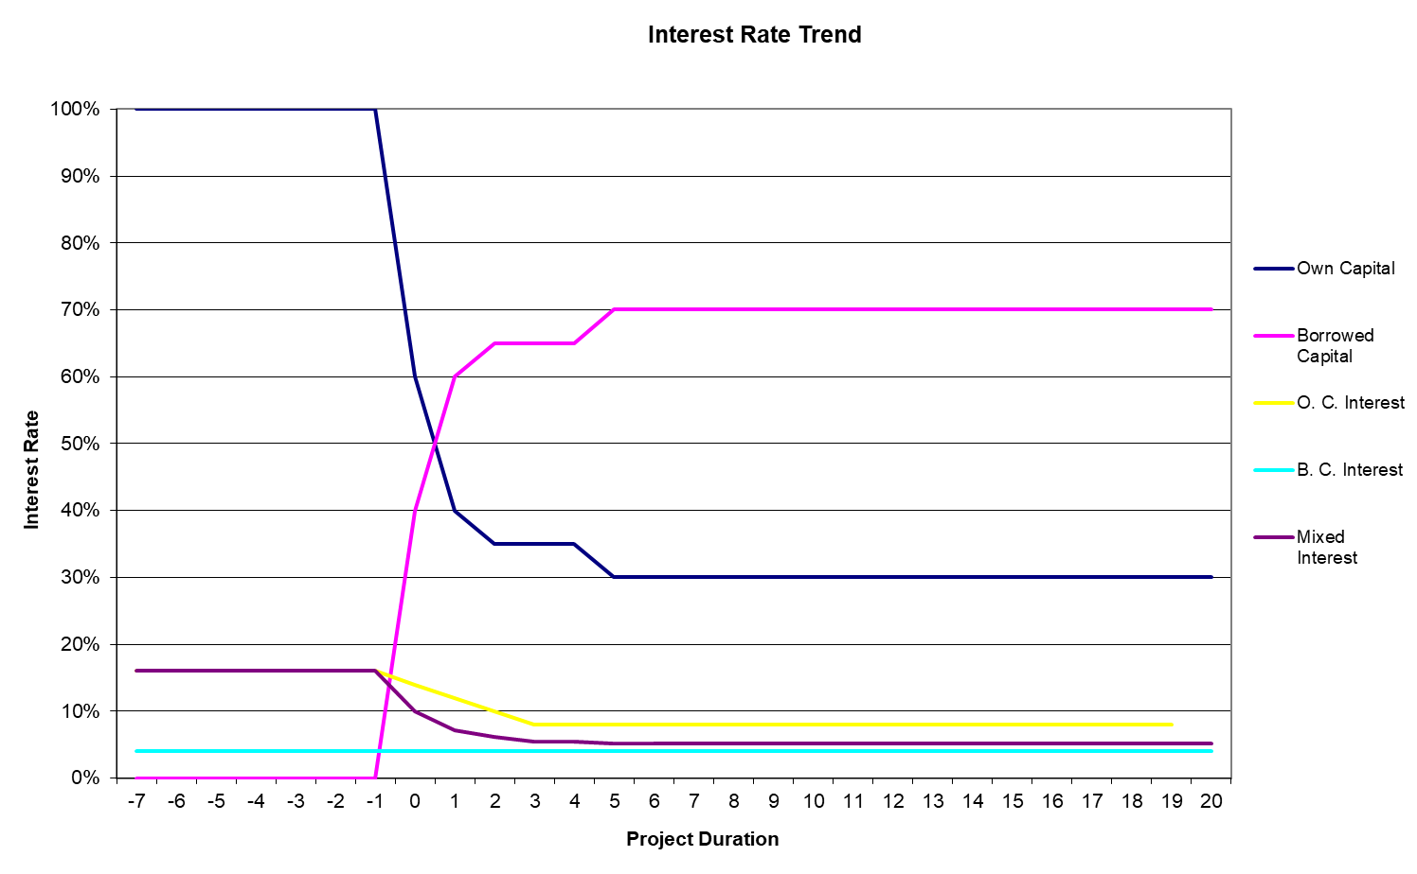
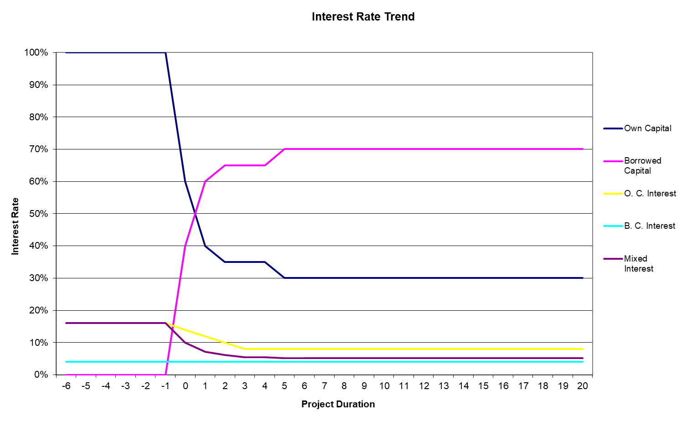
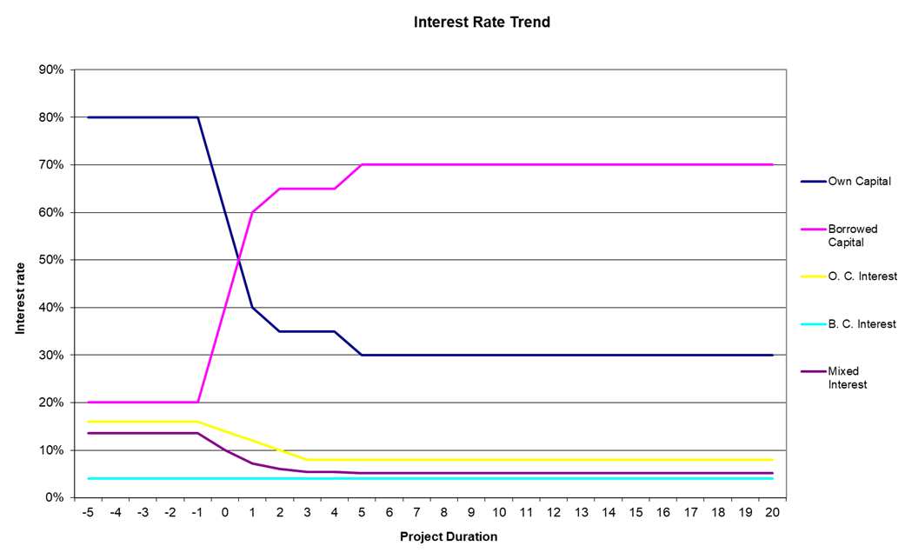
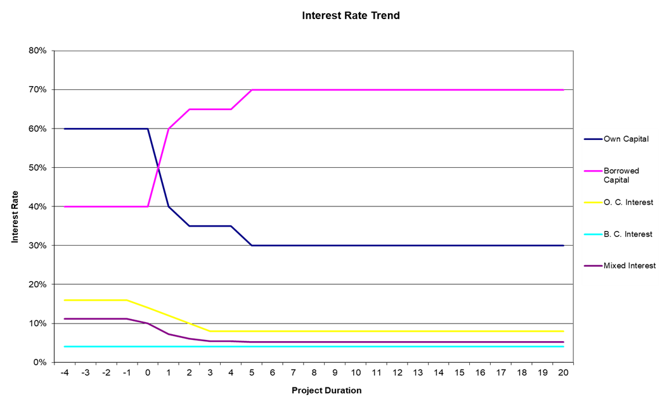
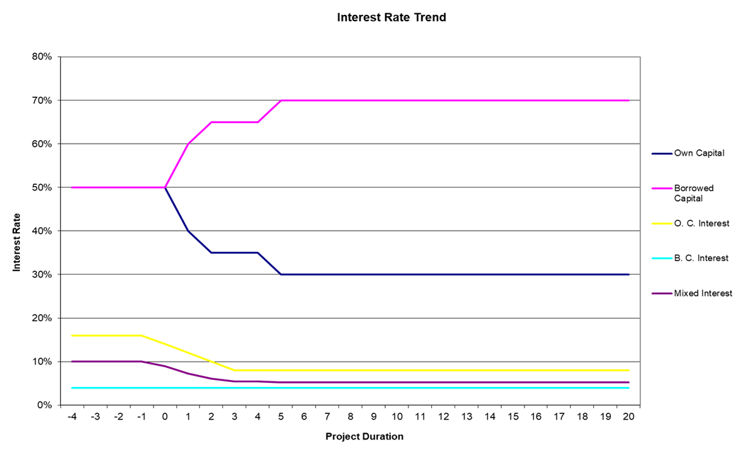
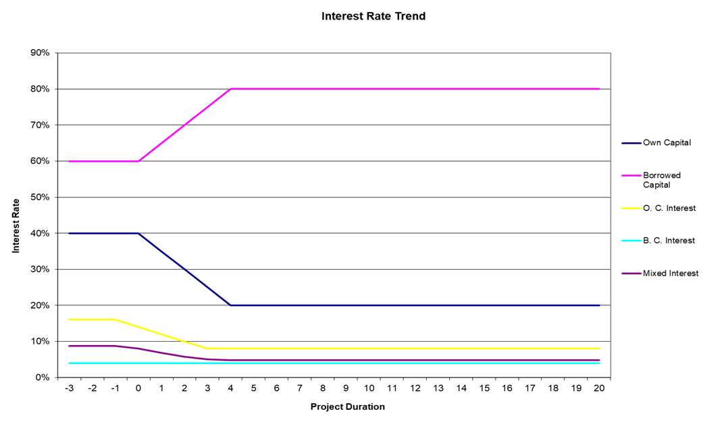

Slide 26
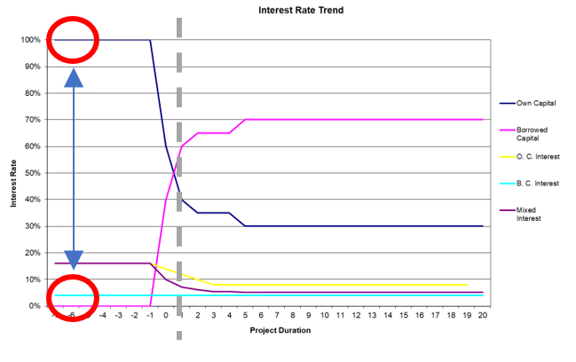
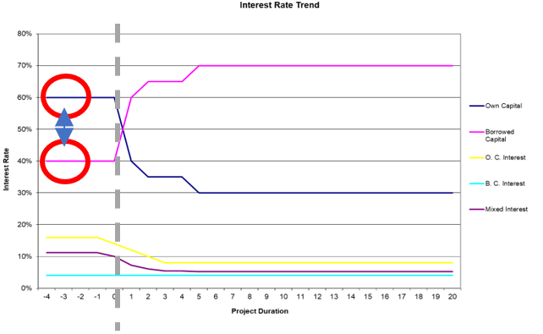
The results of simulation have presented a potential for a second market evaluation tool.
For the evaluation of the market maturity level, range difference between own and borrowed capital could be taken.
The difference of this tool from the CRI level is in its evaluation of the financial development of the project, which in its turn would represent an effectiveness of the applied RMS.
I
Market Maturity Evaluation
with the CRI tool
II
Based on the CRI Level selection of suitable RMS suppot
III
By evaluation the project development, monitor the effectiveness of support system.

Slide 27
V. Transition Criteria and Conditions

Slide 28
Transition I from Grants Schemes to Loans Schemes |  |  | Transition II from Loans Schemes to Public Insurance Schemes
ID | Criteria | Specification | ID | Criteria | Specifications
RE | Clarification of responsible public agencies | - Steady operation permissions - Clarification of public agency jurisdictions and responsibilities - Developed of Legal Security | RE | Improvement of the Licencing Procedures I | - Standardization of required licences - Predictability of the permit issuing time and its durations - Predictability conditions for PPA - Predictability of fees and taxes - Improvement of Legal Security
SA | Providing sufficient evidence for stakeholder trust to take on risks | - Investors: Presence of RMS to transfer significant damage - PD: Presentation of future possibilities in the branch - Population: Information about the Branch and its benefits - Politics: Maintaining course towards Renewable Energies | SA | Providing sufficient evidence for stakeholder trust to take on risks | - Investors: Assurance of possible benefits - PD: Prove of benefits in involvement into the branch - Population: Proven benefits of the Branch in the region - Politics: Maintaining course towards Renewable Energies
TP | Improvement of Technical Background | - Improvement of Geological Data - Presence of corresponding technical resources - Monitoring Systems of the equipment | TP | Improvement of Geological Databases I | - Preliminary Model Developed (Heat and Flow) - Predictability of ESP lifetime - Improved Monitoring Systems of technical equipment (Including Scaling and Corrosion) - Access to underground Data
FPC | Improvement of understanding of the Developed costs. (Trial of various cost calculation models) | - Deviation of planned and actual costs are ca. 25-30%; - Deviation of costs from original plan due to extra expenses | FPC | Increase of prediction precision of the Developed costs. | - Deviation of planned and actual costs are ca. 20%; - Additional expenses become more predictable. - Deviation of OPEX from plan becomes quantifiable
FPR | Increase in predictability of project revenue (Trial of various revenue prediction models) | - Stable prices and stable contractor partners - Contracted purchase quantity -Currency Stability | FPR | Standardization of contracts | - Standardized PPA (power purchase agreement) - High Predictability of revenues
SC | Adjustment of the supplier market | - Presence of suitable products and services - Improved relevant skill sets | SC | Market Specialization | - Developed specialized products and services - Developed specialized skills - First Innovations stimulating the market
MO | Development of Market Opportunities | - Limited trade of the projects in different development stages - Case based Business Models | MO | Improvement of Market Opportunities | - Increased trading of the projects in different development stages - Region Based Business Models
CM | Establishment of companies with minimal experience in development of the geothermal plant | - The local companies are still in the phase of know-how gathering and development of skill | CM | Developer Specialization | - Introduction of core competences - Presence of companies with track records
Transition III from Public Inshurance Schemes to Public-Private-Partnership |  |  | Transition IV from Private-Public-Partnership to Private Scheme
ID | Criteria | Specifications | ID | Criteria | Specifications
RE | - Improvement of the Licencing Procedures II | - Standardization of the licence acquisition conditions - Ensuring long periods of the licences - Securing conditions for PPA - Standardized fees and taxes - Proven Legal Security System | RE | Adjustment of law and regulations to the geothermal market | - Adjustment of law and regulations to the geothermal market - Adjustment of working hours law - Water utilization rights - Mining Laws - Ensured Legal Security System
SA | Providing sufficient evidence for stakeholder to involve or support the Developed of projects | - Investors: Assurance of possible benefits - PD: Proven benefits in excelling the service quality - Population: Agreement to permit development - Politics: Maintaining course towards Renewable Energies | SA | Providing sufficient evidence for stakeholder to involve or support the Development of projects | - Investors: projects become a common practice in the region - PD: Benefits from further development in the branch - Population: Active interest and support of the branch - Politics: Maintaining course towards Renewable Energies
TP | Improvement of Geological Databases II | - Developed Databases and review of Reservoir Model - Extended ESP lifetime - Proven Monitoring Systems of equipment - Access to detailed underground data | TP | Improvement of Geological Data Bases and 3D Reservoir Models | - Validation of Reservoir Model - Proved artificial circulation technologies - Calculable ESP lifetime - Monitoring enabling a preventive maintenance for equipment - Public Availability of Underground Data
FPC | Increase of prediction precision of the Developed costs. | - Deviation of planned and actual costs are ca. 10-15%; - Additional expenses became roughly predictable and taken in contingency budget buffer | FPC | Increase of prediction precision of the Development Costs. | - Deviation of planned and actual costs are ca. 5-10%; - Additional expenses became predictable and taken in contingency budget buffer
FPR | Actualization and improvement of contract standards | (Region/Country/Market Specific) | FPR | Actualization and improvement of contract standards | (Region/Country/Market Specific)
SC | Market Competition | - Emergence of alternative suppliers (Increase of supplier competition) - Significant amount of innovations | SC | Mature Supplier Market | - Stabilization of prices for products and services - Reduced amount of Innovations (Improved quality and developed technology)
MO | Business Models Standardization | - Business Models are stabilized and standardized - Standardized trading of the projects in different development stages - Country Based Standard Business Models | MO | Market is Saturated | - Multiple project opportunities are in healthy competition with one-another - Possibility to invest in Project portfolios aside from single project
CM | Increased number of competent developers | - Start of competition between developer companies (project acquisition stage) - Standardized company procedures | CM | Companies are Mature | - Exchange of knowledge for market improvement (project development stage)

Slide 30
Scenario 1 Grants
Project Construction – 6 Years
Insurance Premium – N/A
Insured Amount – N/A
Risk Occurrence - 40%
Weighted Average Cost of Capital – 8,2 %
Grant for well cost – 60% of the Investment Cost
Outcome
NPV without risk occurrence | 118.813.146
IRR | 11,3%
NPV with risk occurred | 75.142.195
IRR | 5,4%
NPV with risk occurred without RMS | 46.301.968
IRR | 2,9%

Slide 31
Scenario 2 Convertible Grants
Project Construction – 6 Years
Insurance Premium – N/A
Insured Amount – N/A
Risk Occurrence - 30%
Weighted Average Cost of Capital – 7,9 %
Grant for well cost – 50% of the Investment Cost
Since the beginning of repayment in case of success:
Minor Change occurs to Project IRR
Major Change occurs to Investor IRR
Outcome
NPV without risk occurrence | 93.931.592
IRR | 7,3%
NPV with risk occurred | 88.483.025
IRR | 6,4%
NPV with risk occurred without RMS | 64.629.899
IRR | 4,2%

Slide 32
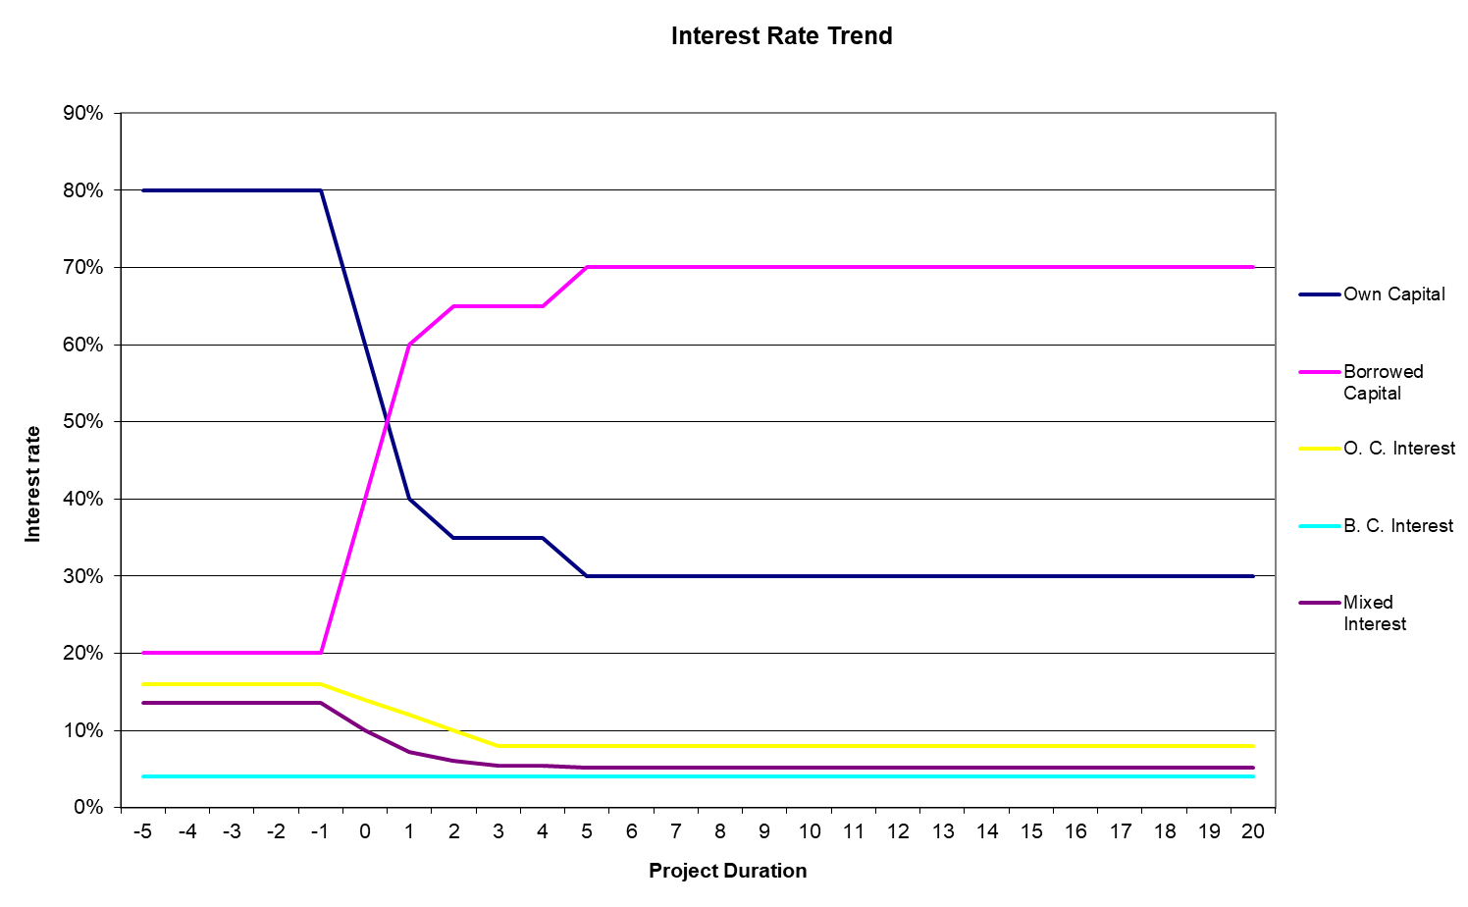
Scenario 3 Repayable Grants
Project Construction – 5 Years
Insurance Premium – N/A
Insured Amount – N/A
Risk Occurrence - 20%
Weighted Average Cost of Capital – 7,1 %
Grant for well cost – 25% of the Investment Cost
Outcome
NPV without risk occurrence | 89.659.631
IRR | 7,2%
NPV with risk occurred | 90.480.078
IRR | 6,6%
NPV with risk occurred without RMS | 81.370.264
IRR | 5,6%

Slide 33
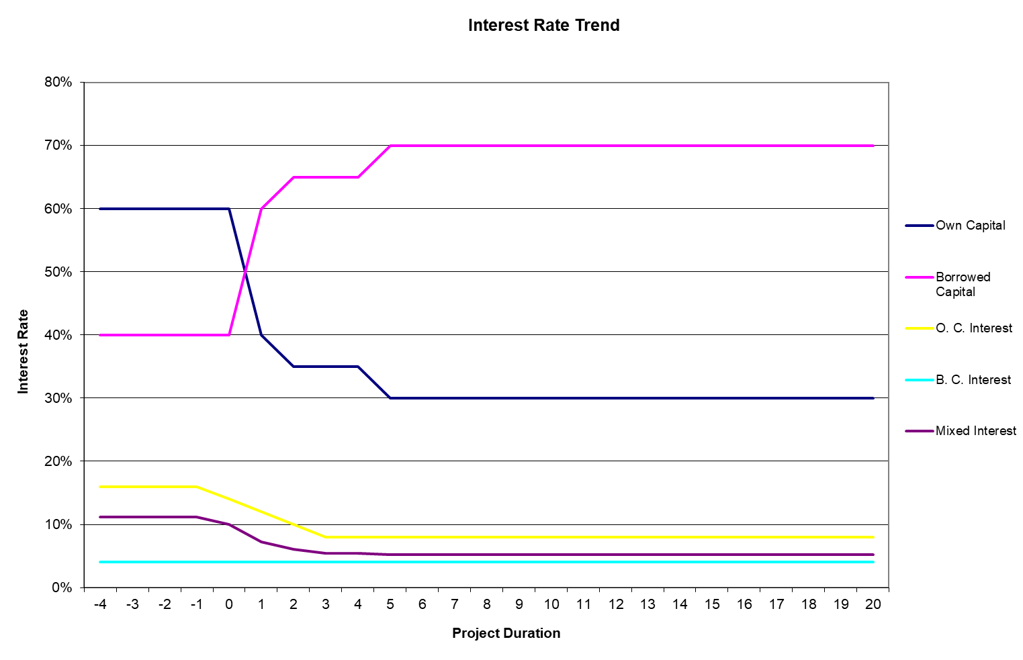
Scenario 4 Public Insurance
Project Construction – 4 Years
Insurance Premium – 10%
Insured Amount – 40 Mil. €
Risk Occurrence - 10%
Weighted Average Cost of Capital – 6,5 %
Grant for well cost – N/A
Outcome
NPV without risk occurrence | 89.217.038
IRR | 7,2%
NPV with risk occurred | 89.217.038
IRR | 7,2%
NPV with risk occurred without RMS | 85.595.405
IRR | 6,4%

Slide 34
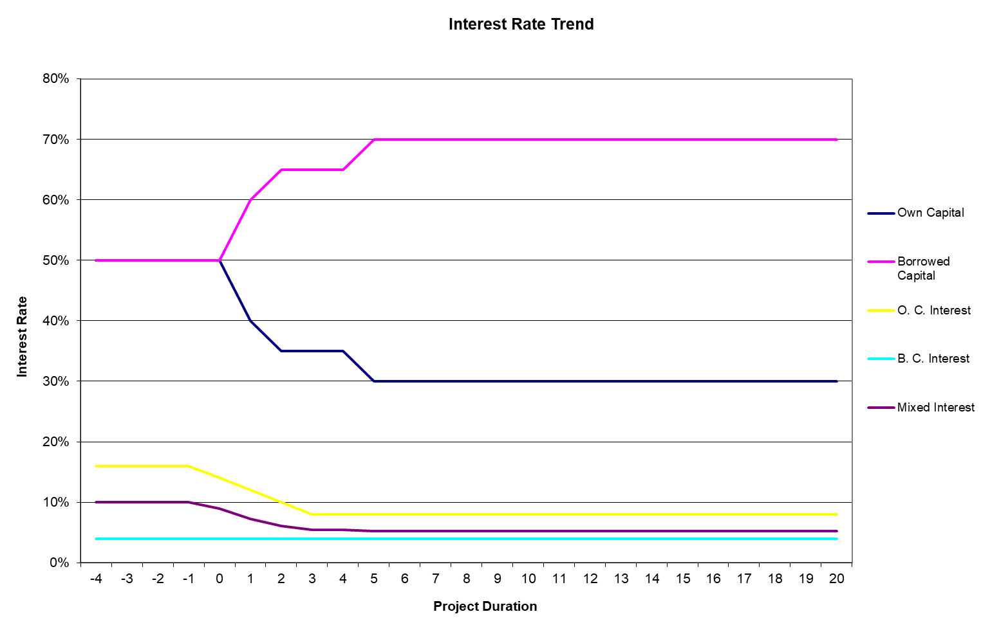
Scenario 5 Pub.-Priv. Partership
Project Construction – 3,5 Years
Insurance Premium – 7,5 %
Insured Amount – 40 Mil. €
Risk Occurrence - 5 % of the Investment Cost
Weighted Average Cost of Capital – 6,3 %
Grant for well cost – N/A
Outcome
NPV without risk occurrence | 88.914.370
IRR | 7,1%
NPV with risk occurred | 88.914.370
IRR | 7,1%
NPV with risk occurred without RMS | 84.194.953
IRR | 6,4%

Slide 35
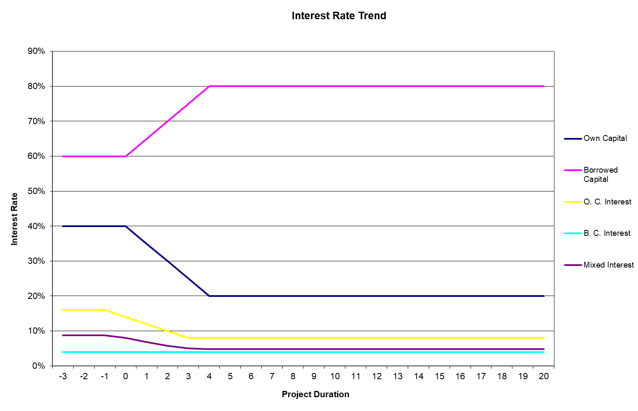
Scenario 6 Private Insurance
(Ideal Case)
Project Construction – 3,5 Years
Insurance Premium – 5 %
Insured Amount – 40 Mil. €
Risk Occurrence - 0 % of the Investment Cost
Weighted Average Cost of Capital – 5,6 %
Grant for well cost – N/A
Outcome
NPV without risk occurrence | 89.890.088
IRR | 7,2%
NPV with risk occurred | 89.890.088
IRR | 7,2%
NPV with risk occurred without RMS | 89.890.088
IRR | 7,2%

