Slide 1

Main achievements towards implementing geothermal
risk mitigation schemes in GEORISK partner countries
Poland
^{Beata Kępińska}
Cooperation: A. Kasztelewicz, M.Miecznik
Mineral & Energy Economy Research Institute PAS
^{IGSMiE PAN / MEERI PAS}
GEORISK Final European Seminar, September 9, 2021

Slide 2
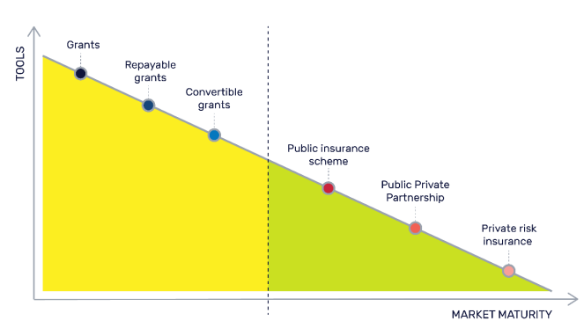
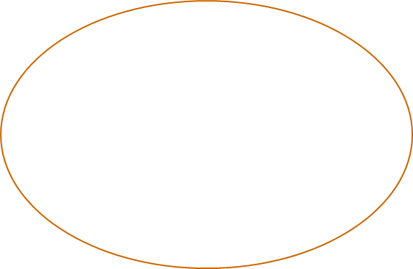

Poland – a two-track situation of geothermal energy market
Pl
Six geoDH installations operating for many years (since 1993–2013):
=> Need to consider a support / RMS in a form of public risk insurance fund (short-term, e.g. next exploitation drillings;
long-term for operation stage)
2. Several – a dozen geothermal installations at initial development stages:
=> Public support (grants, loans) relevant to early development stage introduced gradually on a wide scale, 2016 -2021.
Main beneficiaries: local governments, some other entities. Do not meet all needs and types of particular
investors / operators active for many yrs => time to consider geothermal risk insurance fund (short-, long-term).
Later, such GRIFS will be of purpose also for installations constructed thanks to current public support
2/7

Slide 3
Poland – key role of several public support priority programs to accelerate geothermal projects development (heating / cogeneration) – 2016 – 2021
Geology and mining […]: ~15 exploration wells drilled
Polska Geotermia Plus: drilling 2nd well; extension, retrofitting geoDH; construction new geoDH, CHP, power plants
Accessing geothermal waters in Poland, 2020-2025, Aug 2021: decisions on funding 15 wells, 240 mio PLN / €55 mio
FM European Economic Area, by March 2021: Constructing heat sources using geothermal energy
Total (grants, loans): > 1 billion PLN (2016-2021)* to accelerate geothermal investments on a juvenile market.
Beneficiaries: local governments (mainly), other entities
Coming years – expected connecting geothermal to next district heating systems
These programs act also as kinds of RMS (short–term) for first geothermal research / exploration drillings
(beneficiaries / specially local governments bear almost no risk in case of negative well)
Investors other than LGs are eligible for loans (grants+partial loans).
Not all needs can be covered by these programs: for operating geoDH => GRIF is more and more necessary
- the long-term operational / resource / technical risk, also short-term GRIF is of purpose (as pointed out for yrs)
* 2008-2012: ~ 50 million PLN
3/7

Slide 4
Need to establish a short / long term GRIF – feedbacks from operators,
potential investors cooperating with IGSMiE PAN team
”To accelerate the geothermal energy market development and to attract more investors it is necessary to introduce gradually relevant types of supportive measures / RMS incl. grants, loans and than Geothermal Risk Insurance Fund” (following e.g. the GEORISK proposals)
4/7
Notes:
For a public scheme, there exists usually a legal basis (an act, an ordinance, a decree). The public schemes can be rooted in an Energy Act (Switzerland) or Environment Act (Poland), including CO₂-Act (Switzerland) and climate change legislation (The Netherlands). This implies that schemes are subject of a legislative process involving legislative branches of government (parliament at all levels such as in Belgium or Switzerland). The legislative process is usually supported by administrative units of executive branches of government (several ministries such as the case for The Netherlands or Germany). For ultimate approval, even the sovereign may have to approve, the people, as is the case of Switzerland with a strong component of direct democracy. These processes can be complex if many public entities have to be involved, lengthy and may carry a large degree of uncertainty (Wallonia). This seems to suggest that the implementation of public schemes are best suited for implementation at national levels. Unlike Canada (British Columbia) or Kenya, no country in Europe has a single Geothermal Act which would establish a clear, specialised, consistent and stable basis to meet geothermal needs and support efficiently the development of geothermal energy. It is expected that such a dedicated act would improve the implementation and management of public RMS as it would bring coherence between the various RMS available in a country, for instance when RMS for power and heat projects are not rooted in the same act.
For PPP schemes, it may be that publically held banks or insurance companies are mandated by government or energy agencies to provide low-interest loans or loan-guarantees, sometimes together with commercially operating privately owned entities. In this case, the legal framework comprises both company laws, banking regulations and public laws. The public entity has influence on the PPP through shareholdings. In the case of the French PPP, it is the French Agency for Environment and Energy Management (ADEME) who plays this role in all the PPP currently or soon-to be available RMS in France.
For a private scheme, the legal and regulatory framework is set by articles of association and charters of a commercial entity that states that the private company may engage in developing insurance solutions; or there is a business unit that caters to specific needs of the geothermal industry.

Slide 5
Main Project achievements towards implementing geothermal RMS in Poland
Risk Register for geothermal projects
Overview, lessons learnt and best practices of RMS in Europe (France, the Netherlands, Hungary)
Framework proposal how to establish a geothermal risk insurance fund in Poland
Results of 10 yrs operational and financial simulation of proposed GRIF
GEOriskREPORT online tool
Cooperation with outstanding experienced experts and operators (=> justifying the need to establish a GRIF)
Raising a RMS / GRIF topic once again among key decision-makers and stakeholders, providing
concrete arguments and proposals
Effect => GRIF included e.g. into proposed geothermal roadmap for Poland by 2040, NRP
(under elaboration in the Ministry of Climate and Environment, consultations expected)
Decision-makers await for key Project outcomes
5/7

Slide 6
Closing remarks
GEORISK – one of the most important EU ”geothermal” projects: aimed to create an overall environment facilitating the acceleration of geothermal energy development in many countries
GEORISK provided consistent background and RMS/GRIF proposals to create proper conditions for the long-term stable geothermal investments and its acceleration in Poland
(after necessary adaptation to legal, administrative and formal regulations – national, EU)
It is important that decision-makers take advantage of our proposals.
There are indications that it is and will be so.
6/7

Slide 7
Thank you for your attention!

